Slide 1
Apache JMeter
By Praveen

Slide 2
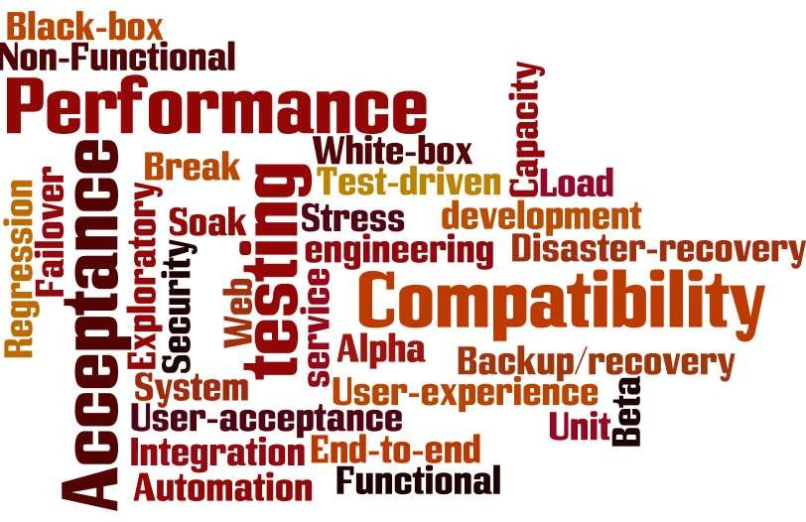
What is Software Testing?
The process of executing a procedure or program or system with the intent of finding errors.
Should be part of all phases of SDLC.

Slide 3



Some Testing definitions
Unit testing is the phase of software testing in which individual units of source code are tested to determine whether they
are fit for use.
Integration testing is the phase of software testing in which individual software units are combined and tested as a group.
System testing of software or hardware is testing conducted on a complete, integrated system to evaluate the system's compliance with its specified requirements.
Performance testing is appropriate in all of these test phases. Just doing it at the end of the lifecycle causes problems.

Slide 4
Comparing Functional & Performance Testing
Functional Testing
Usually done first, to test application functionality not
performance.
Very Comprehensive! Tries to cover all aspects of a system/application.
Tests at the Presentation Layer or user Interface (UI) level.
Performance Testing
Once the application passes functional testing, it is generally
submitted for performance testing
During this process, the system/application is stressed to see how well it performs when used by many users simultaneously
Usually tests at the Protocol or Middleware level although more modern techniques test at the UI.

Slide 5
Comparing Functional & Performance Testing
 | Functional Testing | Performance Testing
1 | Tests the application’s user interface, usability, and front-end functionality | Does not test the application’s front-end functionality
2 | Does not test an application’s scalability or resource usage | Tests an application’s scalability and monitors resource usage
3 | Can not determine how an application/system will perform over time | Designed to determine how an application/system will perform over time
4 | Does not require a fully-functional application | Requires a fully-functional application for given scenarios
5 | One user | Multiple users

Slide 6
What is the Purpose of a Performance Test?
Quantification of risk
Determine likelihood that application performance will meet the business SLA’s
Does not mitigate risk directly, but through identification and quantification of risk, presents tuning opportunities
Validation of application infrastructure
Determine if the deployment environment is adequately sized for
the application to meet business SLA’s.
Minimize extraneous hardware, software and the associated cost of ownership

Slide 7
Performance Testing Helps to Determine
How the application's response time changes if you increase
or decrease the number of users/transactions.
How many users/transactions can simultaneously work with the application without a perceptible slowdown.
What load can crash the application.
How hardware and software changes affect application
performance.

Slide 8
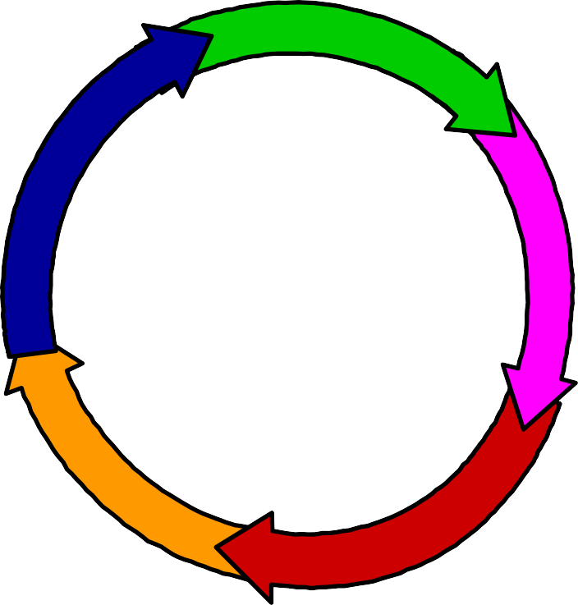
When Should You Consider Performance?
Planning and Design phase
What is the best configuration to support 1000 users?
Forecasting
How many users can be added without affecting system performance?
Development phase
Does the system response time meet SLA requirements?
Deployment phase
Is the system reliable enough to go into production?
Production phase
What are the reasons for degradations in system performance?

Slide 9

Why Consider Performance at Every Phase?
Because the cost of fixing software defects is much higher the later
they occur in the software development life cycle
£125,000
£25,000
£5,000
£1,000
£0
Design
Coding Unit
Integration
System
Release to Maintenance production

Slide 10
Why Performance Matters
“1 second” is the new “4 seconds”
Acceptable Response Time (s)
9
8
7
6
5
4
3
2
1
0
1999
2003
2006
2009
2012
2022?

Slide 11
Performance Testing Objectives
Validate the application to determine if it fulfills its performance goal or targets
Identify the point at which the load becomes so great that the application fails
to meet performance requirements
Determine if the application will support typical (normal) production load conditions
Tune the application for maximum performance by identifying the optimal system configuration
Reduce hardware / SaaS platform costs
Locate bottlenecks including those in I/O, server, network, and database

Slide 12








Performance Testing helps Identify
Application infrastructure
Web Servers
Capacity limits
WAN Sensitivity
App Servers
Configuration Issues
Slow Methods
Slow transactions
DB Servers
Contention Issues
Bad SQL

Slide 13
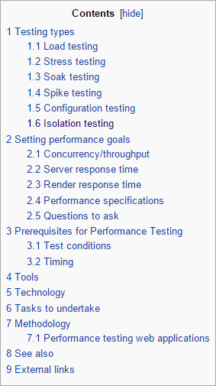
Basic types of Performance Test
Baseline
Load
Stress
Soak
Isolation
Configuration

Slide 14

Types of performance test
120
100
80
60
40
20
0
“Normal” Load Profile
vUsers
10 30 50 70 90 110 130 150 170 190 210 230 250 270 290
Elapsed time
Ave load Peak load Typical test
“Normal” load profile Common in performance tests
“Soak Test” Load Profile
120
100
80
60
40
20
0
vUsers
Soak test Useful for identifying problems which occur over time
10 30 50 70 90 110 130 150 170 190 210 230 250 270 290
Elapsed time
Ave load Peak load Soak test

Slide 15

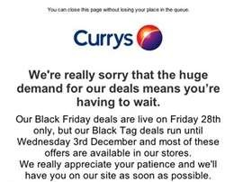
Types of performance test
Load Profile
350
300
250
200
150
100
50
0
“Stress/Break” test
Commonly requested
vUsers
10 30 50 70 90 110 130 150 170 190 210 230 250 270 290
Elapsed time
Ave load Peak load Break test
Load Profile
120
100
80
60
40
20
0
vUsers
“Spike” test
Commonly requested
10 30 50 70 90 110 130 150 170 190 210 230 250 270 290
Elapsed time
Ave load Peak load Spike test

Slide 16
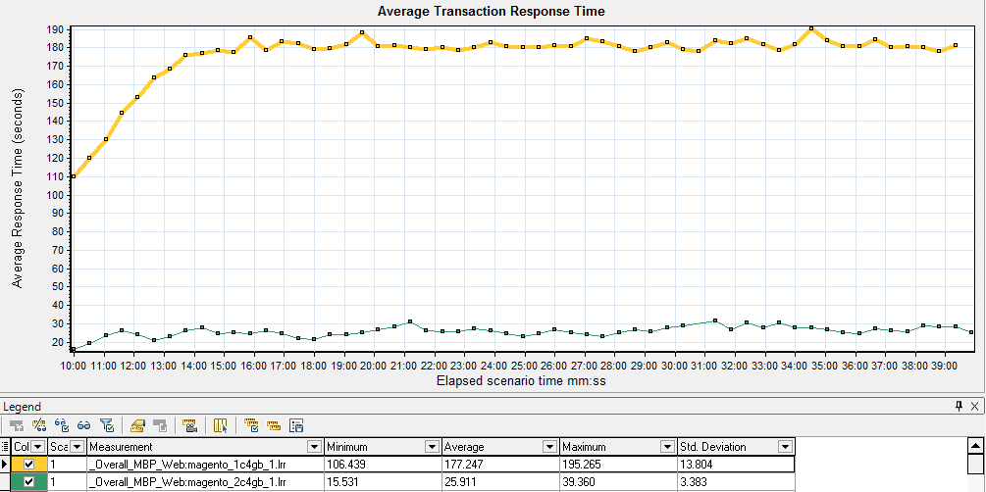
Baseline Test
1 user for a set period of time or number of iterations
e.g. to determine pacing / think time
A test at “normal load” to establish a baseline for comparison with future tests
e.g. higher load or under different conditions
Response time – 1 CPU 4GB RAM
Response time – 2 CPU 4GB RAM

Slide 17
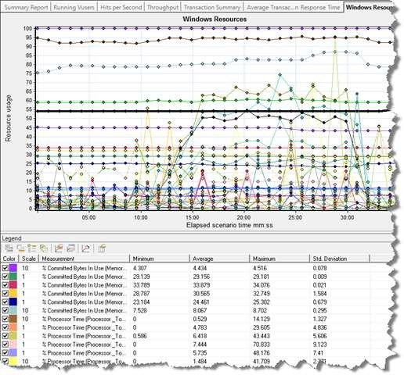
Load Test
The “Classic” performance test
Validates the system/application to determine if it meets the performance targets.
Provide information that will assist in performance tuning under various
workload conditions, hardware configurations, and database sizes
Helps identify key performance data such as:
Capacity
Latency
Response time
Throughput
Memory Management

Slide 18

Load Test
40
35
Response Time
30
25
20
15
10
Response Time
5
1
SLA
10
50
100 200
Number of users
500
1000 2000

Slide 19




Stress/Break Test
Identifies capacity limits of the system/application or infrastructure
Identifies potential problems before going live
Determines whether app can provide acceptable response times and
throughput under extreme conditions
350
300
250
200
150
100
50
0
10 30 50 70 90 110 130 150 170 190 210 230 250 270 290
Elapsed time
Ave load Peak load Break test
Load Profile
vUsers

Slide 20
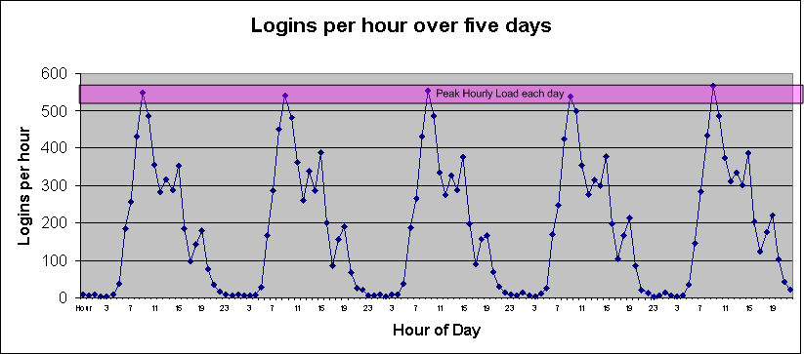
Soak Test
Long Running test, identifies problems over time
– Test usually (not always) involves multiple business transactions
Measures performance and efficiency of the system
(hardware and software) to:
–
–
determine acceptable performance under load identify time-related problems such as memory leaks.

Slide 21
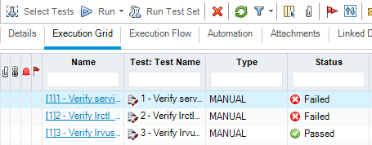
Isolation Test
Repeating a test which was known to cause a fault/defect.
Used to “home in” on problems revealed by other forms of performance testing. e.g. deadlocks, problems with specific test data
May involve repetition of a load, stress or soak test scenario to point of failure.
Repeat test whilst changing code / application configuration until defect
can be closed.

Slide 22
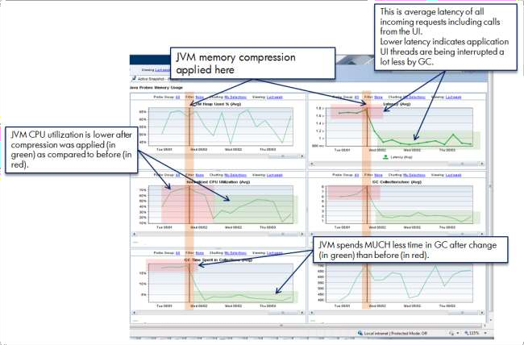
Configuration Test
Used to determine optimum settings for configuration items such as:
Load balancing
Connection pool allocation
Web, Mid-tier and Database configuration
Common in “new build” projects

Slide 23
Performance Testing Process
Preparation
Planning & requirements capture
Determine realistic performance testing goals
Prepare testing environment
Prepare test data
Identify performance testing use cases
Capture, modify and validate use cases as scripts / scenarios
Execution and Analysis
Prepare environment / test data
Execute performance test(s)
Monitor impact of load on servers/database/networks
Analyze results
Submit defects
System tuning
Repeat execution and analysis process until performance testing goals met.

Slide 24


Automated Testing Tools
It is nearly impossible to effectively performance test without automation!
Manual testing is not manageable!
Manual testing is not repeatable!
Manual testing is not accurate!
✗
✓

Slide 25
Benefits of an Automated Performance Testing Tool
Performance testing is very difficult without one
Performance testing without a tool relies on hardware and personnel to generate load, generally with wildly inaccurate results.
Without automation the final test reports may be unreliable..
User responses collected and compiled into a report may contain as much human error as real data.
The cost of repeating a 'manual' test is equal to cost of the first test. When using a performance testing tool, costs go down as you repeat your tests.

Slide 26


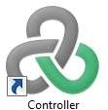

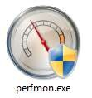
How do Automated Performance Testing Tools Work?
Most automated performance testing tools including LoadRunner have the following components:
Script Recorder (VuGen)
Load Injector / Load Generator (Load Agents)
Test Configuration and Management (Controller)
Performance Monitor (Controller & other components)
Analysis

Slide 27
Test Configuration
Listener
8080
443
Controller
LG(s)
HTTP
80/443
HTTP
HTTP
80/443
LG(s)
80/443
AUT
Client Network

Slide 28


Script Recorder
Records end-user activity and generates transaction scripts.
Application Infrastructure
Web Servers
End- User
HTTP – XML – SAP
App Servers
DB Servers

Slide 29
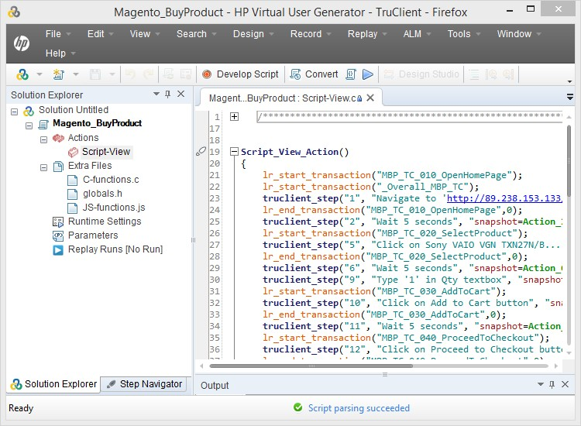
Script Recorder - VuGen

Slide 30
Load Generator aka. Injector
Application Infrastructure
Web Servers
App Servers
DB Servers
Generated Load

Slide 31
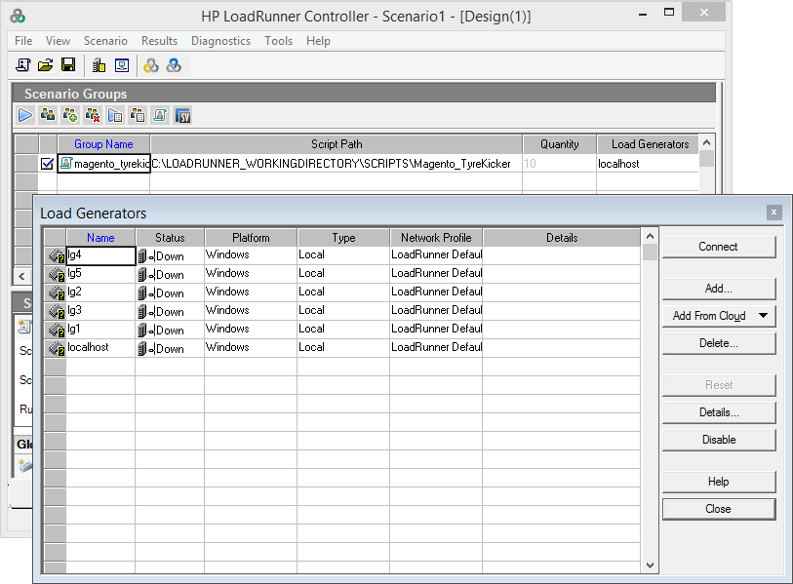
Load Generator

Slide 32
How does a Load Injector work?
Mimics client behavior:
Submits multiple requests to the AUT
Waits for a period of time after the site sends a reply to the request (think time) then submits a new request
Can emulate thousands of concurrent users (virtual users) to test the application scalability
Virtual User (VUs) mimic the behavior of a real user
A performance test is valid only if a virtual users' behavior has characteristics similar to those of actual users:
Follow patterns similar to real users
Use realistic think times

Slide 33

Test Configuration and Management
Test Controller manages the performance test and “controls” the action of load generators
Application Infrastructure
Web Servers
App Servers
DB Servers
Test Control
Generated Load

Slide 34

Performance Monitor(s)
Capture server and network performance metrics
Application Infrastructure
Web Servers
App Servers
Generated Load
DB Servers

Slide 35
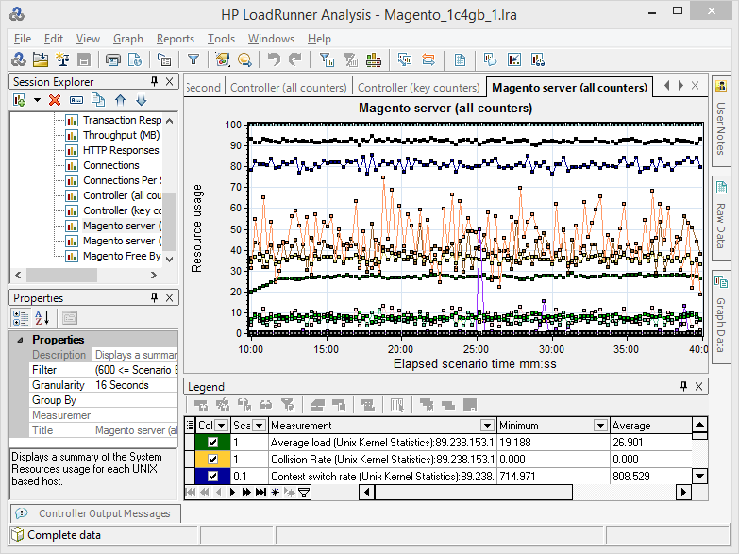
Performance Monitor(s)

Slide 36
Analysis Module
Application Infrastructure
Web Servers
App Servers
Generated Load
DB Servers

Slide 37
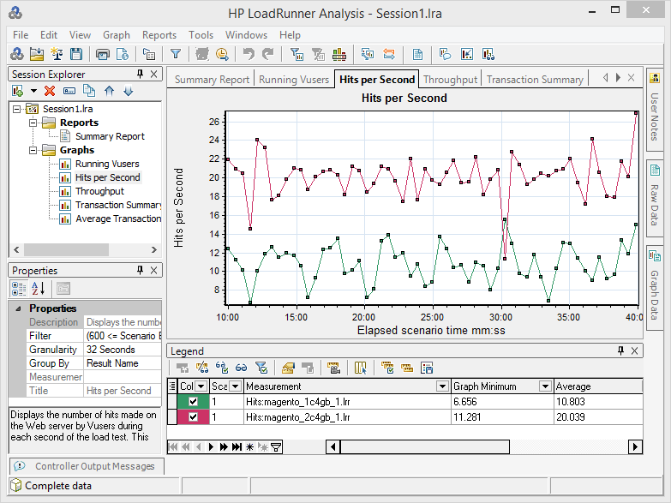
Analysis Module

Slide 38
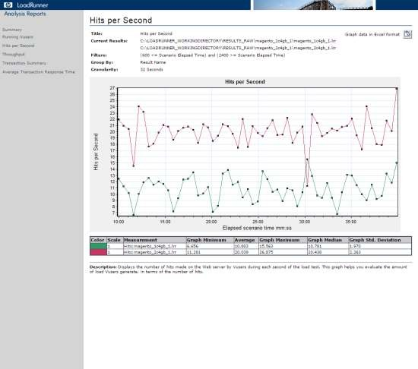
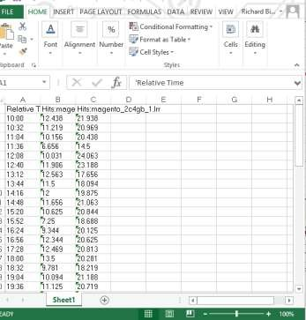
Sample Report

Slide 39
Testing Jargons
Introduction
History
Protocols
Features
How It works?
Installation
Thread Group
Controller
Execution Order
Demo

Slide 40
“Quality means doing it right even when no one is looking.”
- Henry Ford

Slide 41
Testing Jargons
Performance Test − This test sets the best possible performance expectation under a given
configuration of infrastructure. It also highlights early in the testing process if any changes need to be made before the application goes into production.
Load Test − This test is basically used for testing the system under the top load it was designed to operate under.
Stress Test − This test is an attempt to break the system by overwhelming its resources.

Slide 42
Introduction
jMeter is an Open Source testing software. It is 100% pure Java application for load and performance testing.
jMeter is designed to cover categories of tests like load, functional, performance, regression, etc.

Slide 43
History
Stefano Mazzocchi of the Apache Software Foundation was the original developer of JMeter. He wrote it primarily to test the performance of Apache JServ (now called as Apache Tomcat project). Apache later redesigned JMeter to enhance the GUI and to add functional testing capabilities.

Slide 44
Protocol Support
Web - HTTP, HTTPS
SOAP / REST
FTP
Database via JDBC
LDAP
Message-oriented middleware (MOM) via JMS
Mail - SMTP(S), POP3(S) and IMAP(S)
Native commands or shell scripts
TCP

Slide 45
Features
Being an open source software, it is freely available.
It has a simple and intuitive GUI.
JMeter can conduct load and performance test for many different server types − Web - HTTP, HTTPS, SOAP, Database via JDBC, LDAP, JMS, Mail - POP3, etc.

Slide 46
Cont...
It is a platform-independent tool. On Linux/Unix, JMeter can be invoked by
clicking on JMeter shell script. On Windows, it can be invoked by starting the jmeter.bat file.
It has full Swing and lightweight component support (precompiled JAR uses packages javax.swing.* ).

Slide 47
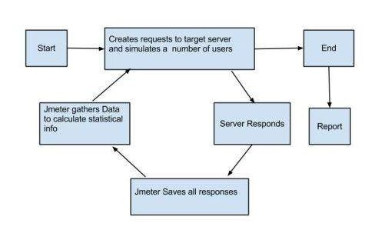
How jMeter works?

Slide 48
Installation
Set JAVA_HOME
Download jMeter (http://jmeter.apache.org/download_jmeter.cgi)
Set JMETER_HOME (export PATH=$PATH:$JMETER_HOME/bin)
Run jMeter via Command jmeter

Slide 49
Thread Group
Thread Group elements are the beginning points of your test plan.
Set the number of threads
Set the ramp-up period
Set the number of times to execute the test

Slide 50
Controller
JMeter has two types of Controllers:
Samplers
Logic Controllers

Slide 51
Samplers
Samplers allow JMeter to send specific types of requests to a server. They simulate a user request for a page from the target server.
HTTP Request
FTP Request
JDBC Request
Java Request
SOAP/XML Request
RPC Requests

Slide 52
Logic Controller
Logic Controllers let you control the order of processing of Samplers in a Thread. Logic controllers can change the order of a request coming from any of their child elements.
Simple Controller
Loop Controller
Once Only Controller
Switch Controller
If Controller
While Controller
ForEach Controller
Recording Controller

Slide 53
Listeners
Listeners let you view the results of Samplers in the form of tables, graphs, trees, or simple text in some log files.
Graph Results
Spline Visualizer
Assertion Results
View Results Tree
View Results in Table
Simple Data Writer
Monitor Results
Aggregate Graph

Slide 54
Assertions
Assertions allow you to include some validation test on the response of your request made using a Sampler.
Response Assertion
HTML Assertion
Compare Assertion
XPath Assertion
Duration Assertion
Size Assertion
XML Assertion
BeanShell Assertion

Slide 55
Configuration Elements
Configuration Elements allow you to create defaults and variables to be used by Samplers. They are used to add or modify requests made by Samplers.
HTTP Authorization
HTTP Cache Manager
HTTP Cookie Manager
HTTP Proxy Server
JDBC Connection
Login Config Element
LDAP Request Defaults
HTTP Request Defaults

Slide 56
Pre-Processor Elements
A pre-processor element is something that runs just before a sampler executes. They are often used to modify the settings of a Sample Request just before it runs, or to update variables that are not extracted from response text.
HTML Link Parser
JDBC PreProcessor
HTTP User Parameter
User Parameters
HTTP URL Re-writing
RegEx User Parameters

Slide 57
Post-Processor
A post-processor executes after a sampler finishes its execution. This element is most often used to process the response data, for example, to retrieve a particular value for later use.
Regular Expression
XPath Extractor
CSS/JQuery Extractor
JDBC PostProcessor
BeanShell PostProcessor
Debug PostProcessor

Slide 58
Execution Order
Configuration elements
Pre-Processors
Timers
Sampler
Post-Processors
Assertions
Listeners

Slide 59
Simple JDBC Demo

Slide 60
Http Request Demo with Recording

